Slide 1




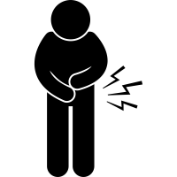









Deworming
Worm Infestation
Children are at high risk for worm infestations. This can severely affect your child’s nutrition, growth, and learning. Taking deworming pills can help children avoid the serious health effects of worm infestations.
Signs and symptoms of worm infestation
Stomach pain and bloating
Diarrhea and nausea
Fatigue
Weight loss
Passing blood/worms in stool
Benefits of deworming
More energy
Reduces worm infestation
Improves immunity
Improves nutritional uptake
Improves learning and concentration
Speak to the clinic today about getting deworming pills for your child!
RURAL PRIMARY HEALTH IMPROVEMENT PROGRAM.

