Slide 1


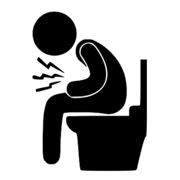





Dehydration & Diarrhea
What is dehydration?
Did you know that the human body is made up of 75% water? Water is involved in many important body functions. When we lose too much, water, we become dehydrated. This can cause serious harm on the body, particularly in young children. The most common cause of dehydration is diarrhea. This occurs when your body excretes too much water, causing dehydration.
How do I treat diarrhea?
The World Health Organization recommends oral rehydration salts and zinc supplementation as simple and effective ways to treat diarrhea.
Oral Rehydration Salts (ORS)
Zinc Supplementation
You can make your own ORS at home!
Mix the following together:
1 Litre (5 cups) of water
6 teaspoons of sugar
½ teaspoon of salt
Stir the mixture until the sugar and salt dissolves.
Benefits of zinc include:
Reduces the severity and duration of diarrhea
Helps prevent future diarrhea episodes
Support child growth
Boosts immune function
Speak to your healthcare provider today about zinc supplementation for your child.
This solution should be covered and not kept for more than 24 hours due to risk of bacterial contamination.
RURAL PRIMARY HEALTH IMPROVEMENT PROGRAM.

