Slide 1



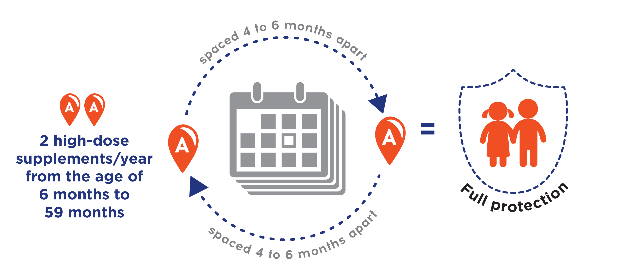

Vitamin A Supplementation
What is Vitamin A?
Vitamin A is an important supplement that is essential for your body. Vitamins cannot be made in the body so it must be included in the food we eat. If we are not getting enough vitamins from our diet, it is important to take supplements to ensure our body has the nutrients it needs to survive. Vitamin A deficiency is a common problem in Nigeria, but it can be easily treated with supplements!
Benefits of Vitamin A Supplementation
Maintains a strong immune system
Prevents blindness and hearing loss
Reduces the incidence of measles and diarrhea
How often does my child need supplementation?
Speak to the clinic today about getting Vitamin A supplements for your child!
https://data.unicef.org/resources/vitamin-a-coverage/
RURAL PRIMARY HEALTH IMPROVEMENT PROGRAM.

